Slide 1


Predicting Term Deposit Subscription
This presentation explores the use of data analytics to predict term deposit subscriptions, optimize marketing strategies, and improve campaign efficiency.

Slide 2

Objective
1
Predict Subscriptions
Accurately predict whether clients will subscribe to a term deposit based on their unique characteristics.
2
Target Clients
Identify and target the most promising customer segments with tailored marketing campaigns.
3
Increase Efficiency
Improve the effectiveness of marketing efforts by focusing resources on high-potential customers.
4
Reduce Costs
Optimize marketing expenses by minimizing spending on campaigns with low conversion rates.

Slide 3
Data Exploration
Demographics
Financial Data
Behavioral Patterns
Analyze client demographics such as age, gender, marital status, and education level.
Examine financial information including income, savings, and existing investments.
Study customer interactions and patterns of communication, such as frequency of contact and past product usage.

Slide 4
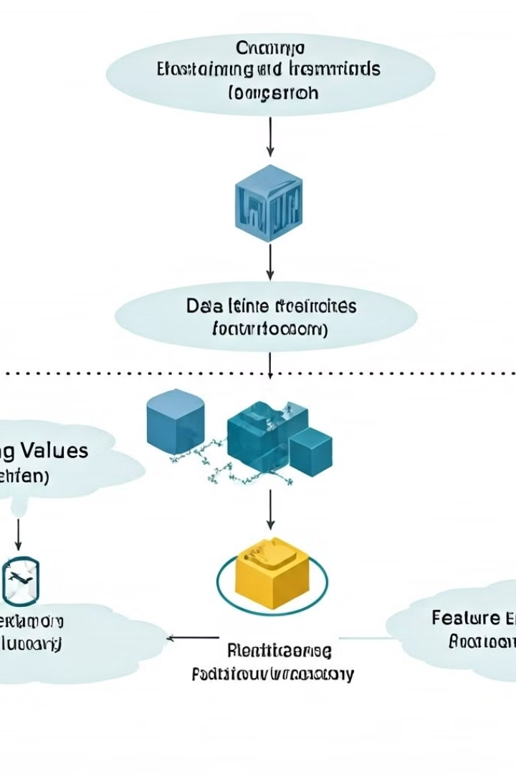
Data Preprocessing
1
Missing Values
Impute or remove missing data points to ensure data completeness.
2
Outlier Handling
Identify and address outliers using appropriate techniques, such as capping or removal.
3
Feature Engineering
Create new features by combining or transforming existing variables to enhance model performance.
4
Encoding
Convert categorical features into numerical representations suitable for machine learning models.

Slide 5
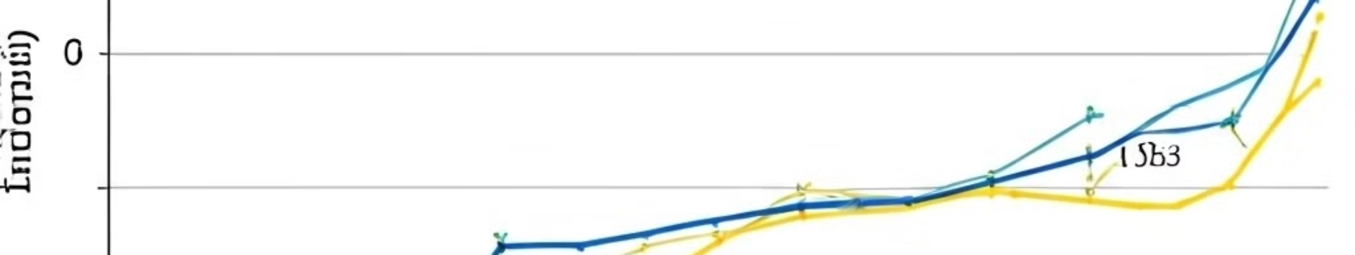



Modeling
Logistic Regression
Pipeline Implementation
Performance Evaluation
Develop a logistic regression model to predict the probability of term deposit subscription.
Implement a pipeline that includes preprocessing steps, feature selection, and model training.
Assess model performance using metrics such as accuracy, precision, recall, and F1-score.

Slide 6
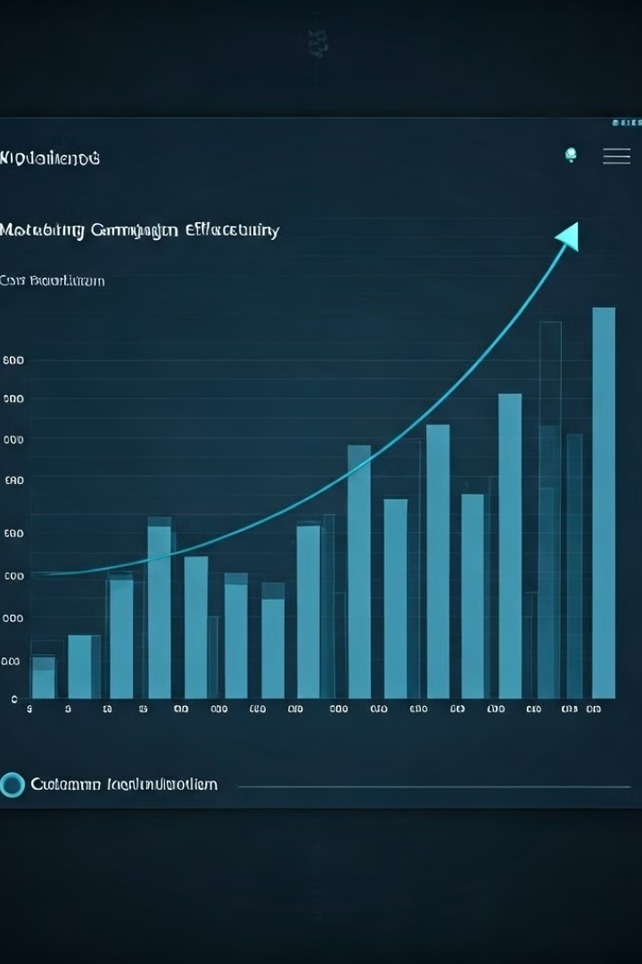
Business Impact
Improved Targeting
Increased Accuracy
89.86%
Cost Reduction
Optimized Marketing Spend
Reduced by 15%
Increased Campaign Effectiveness
Higher Conversion Rates
20% Increase

Slide 7
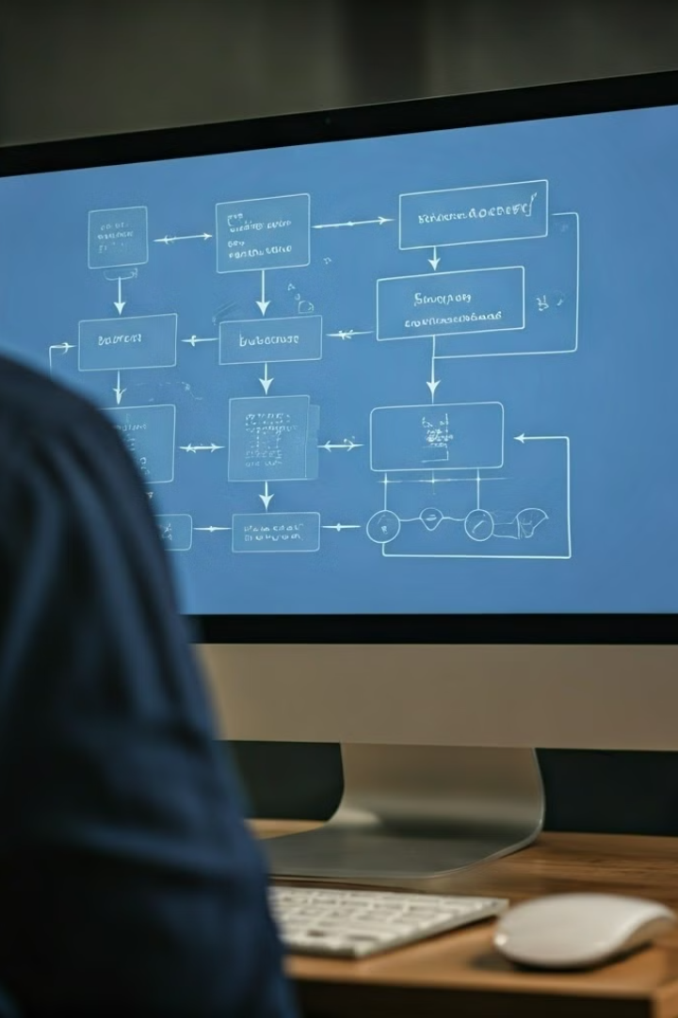
Future Work
Feature Exploration
Investigate additional features and their potential impact on model accuracy.
Model Enhancement
Explore advanced machine learning algorithms and techniques to further improve model performance.
Data Monitoring
Continuously monitor data streams and update the model to adapt to changing trends and patterns.

Slide 8

Conclusion
By leveraging data analytics, we have achieved significant improvements in predicting term deposit subscriptions, optimizing marketing campaigns, and ultimately driving business growth.

